Slide 1



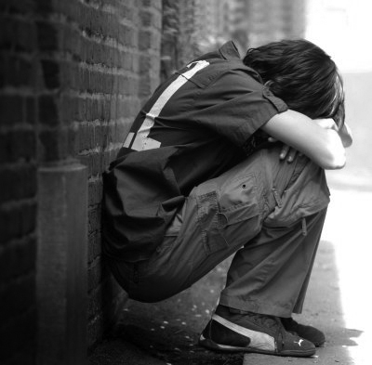



YOUTH FIRST!
Core Concepts
Dallas County Juvenile Probation Department
Dr. Terry S. Smith, Executive Director

Slide 2
YOUTH FIRST! Goals
YOUTH FIRST!
Reduce DMC
First Time Offender Programs
Buy-In
Climate of Culture
Shift in Paradigm
Interns/Mentors/
Volunteer/
Bilingual Staff
Peer Advisory Council
Community Partners Program
Addressing Family Dynamics
Educational Advocacy Program
Evening Reporting Center

Slide 3
Pillars of Change
Change
Dignity & Respect |  | Boundaries/ Engaged Supervision |  | Safe Environment |  | Organization & Consistency |  | Therapy, Programs & Rehabilitation

Slide 4

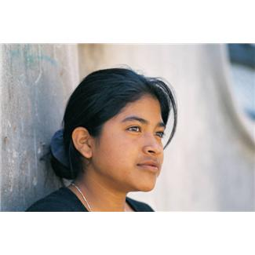
Pillars of CHANGE Core Concepts
1. Dignity and Respect
2. Boundaries and Engaged Supervision
3. Safe Environment
4. Organization and Consistency
5. Therapy, Program and Rehabilitation

Slide 5
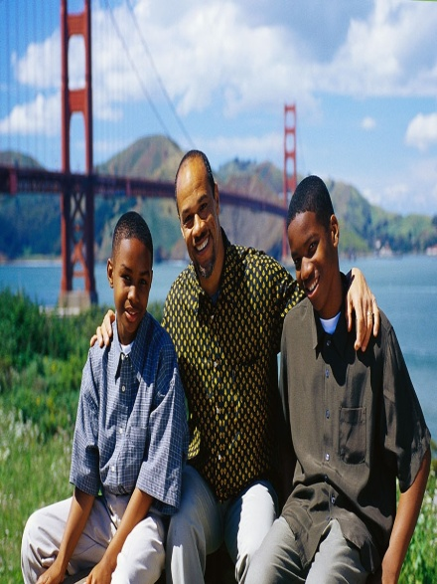

1. Dignity and Respect
Biggest key to change and success
Treating youth and families with dignity and respect at all times
Setting high levels of expectations
Intervening with youth who are disrespectful
Teaching youth that the more respect they show others, the more they will reap for themselves

Slide 6
2. Boundaries and Engaged Supervision
Staff must be the front line for youth
Boundaries may include:
  Physical
  Emotional
  Mental
Providing immediate feedback for inappropriate behaviors
Provide alternative behavior choices
Should be professionally established
Warning signs of unhealthy boundaries include:
  Sharing personal information
  Too involved with family
  Intimate information about themselves/relationships
  Trying to “save” the youth and intervene in sanctions
  Defending youth although violated policy, procedure and/or probation.
Engaged supervision (alert)

Slide 7

3. Safe Environment
Comprehension and buy into mission statement, interactions with youth
Demonstrate same tone of respectfulness and high expectations
Strive to develop and maintain relationships
  Youth, administration, community partners, vendors and education collaborators
Connections are necessary to instill the rebuilding of self-esteem and personal worth among our youth

Slide 8
4. Organization and Consistency
Cleanliness and order
  Programming
  Living and sleeping areas
  Building in general
Youth participate in life skills
  Landscaping, community service, other projects
  In order to convey responsibility for environment
Being consistent with policy and limits, allow youth to complete expectations and achieve goals
Youth are aware that the rules do not change based on daily interactions
Enforce the rules of the Court consistently

Slide 9


5. Therapy, Programs and Rehabilitation
Maintaining a positive atmosphere within treatment groups requires continuous supervision by knowledgeable dedicated staff
Possess the facilitation skills needed to de-escalate tensions using each situation as an opportunity to assist youth to explore behaviors and provide options
Focus on personal growth is constant
All Staff are to be considered treatment staff

Slide 10
Definitions
Rehabilitation
  To restore to useful life, as through therapy and education or To restore to good condition, operation, or capacity. *
  ‘child savers’ to ‘child law advocators’ to ‘child crusaders’ back to ‘child savers’ with a strong emphasis on therapeutic rehabilitation
  Main goal: prevent re-offending and allow child successful reintegration
  Rehabilitation spending far exceeds Ivy League education
  Justified less than needed outcomes and abusive living conditions, in the guise of rehabilitating youth
*Source: Wikipedia

Slide 11
Definitions, continued
Therapy
  Therapeutic treatment especially of bodily, mental, or behavioral disorder
  Establishing strong foundations for success basic values
    Approval
    Acceptance
    Achievement
    Attachment
  Provide therapeutic intervention to challenge young people and change attitudes, beliefs and behaviors
  Change comes from internal choice of young people
  Engaging in treatment
  Consider new directions

Slide 12
Collaboration with CJAB and Juvenile Probation
The support for legislative matters as it references juveniles, including sending agreement letters, discussions in Austin and with legislative personnel;
Having the Board support or not support legislature that is conflicting to the best interest of the juvenile justice system;
Assist us in meetings with collaborative law enforcement agencies to address DMC;
Continue to inform the community of the issues as it relates to our specialty populations, i.e.; juvenile mental health issues; girls in trafficking; GLBTQ youth;
Supporting funding/grant endeavors or opportunities, using CJAB as a partner;
Assist Juvenile Probation in establishing community partnerships focused on reducing delinquent activity;
Partner with Juvenile Probation to establish a “YOUTH FIRST” Initiative (fundamentally, community forums with us, community partners and law enforcement to concentrate on delinquent behaviors and community reintegration.
Community Partners Program

