Slide 1



Dallas county District clerk’s office

Slide 2
overview
Criminal
Civil /Family/ Juvenile
Records
Passport
Trust, Accounting, & Collections

Slide 3
Mission statement
The mission of the District Clerk is to provide the judicial system and the public with information and support in the most technologically advanced method possible by:
Fulfilling our statutory duties as record custodian and fee officer to the best of our abilities
Fostering an environment for our employees that encourages the development of new ideas and the willingness to improve productivity
Implementing our goals and objectives with a team-based approach to decision-making throughout the organization
Striving to be a leader and example to other county and state agencies

Slide 4
District clerk’s – criminal sections
*Lew Sterrett Justice Center Magistrate Court
24/7/365 Operation
* 17 District Criminal Courts, 2 Auxiliary Magistrate Courts, & 1 Drug Court
*Criminal Process and Support
Writs &Appeals
Subpoenas & Indictments
Expunctions & Non-Disclosures
Bond Forfeitures
*Criminal Collections

Slide 5
Reporting – criminal
*Protective Orders Report
24 hour
* Restitution Payments Report
Payout to victims
* PSRS (Public Safety Report System)
Conditions of bonds
*Court Disposition Report
Case activity for the courts

Slide 6

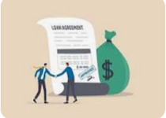


District clerk’s – civil division
Civil:
Motor Vehicle Accident, Debt Contract/Collection,
Personal Injury and Other Civil
Civil/Tax (13)(1) Delinquent Tax cases
Family:
Divorce, Adult Name Change, SAPCR, Adoption and
Protective Orders
Family/IVD (7) OAG = Office of Attorney General
Juvenile:
Civil, CPS, Adoption, and Delinquent
Juvenile (2)(1) CPS Child Protective Services and Delinquent cases

Slide 7
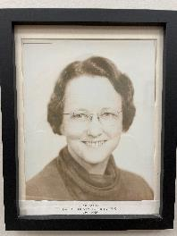
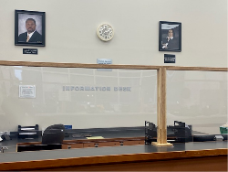
Issuances and requests:
File Desk
File new suits, electronic filing
Document Production:
Issuing citation, notices, subpoenas, writs, TRO, & injunctions

Slide 8
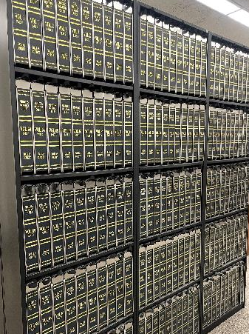
District clerk’s – records division
Civil, Family, Criminal, & Juvenile
Retrieve Records for Customers
Minute Books – Permanent Records
Microfilm/Microfiche

Slide 9
Hard Copies Files Records

Slide 10
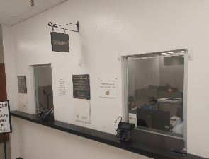
trust
We are the court’s registry.
Set up trust funds for minors involved in accident lawsuits.
Investments for minors

Slide 11




District clerk’s – passport division

Slide 12
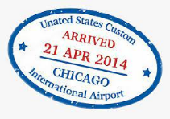
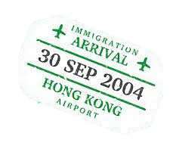
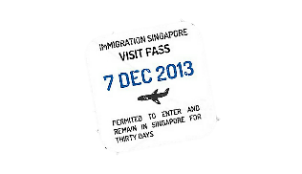
passport division
Three Passport Locations
Downtown - George L. Allen, Sr. Courts Building
600 Commerce Street Dallas, Texas 75202-4606
East - East Dallas Government Center
3443 St. Francis Avenue Dallas, Texas 75228
North - North Dallas Government Center
6820 Lyndon B. Johnson Freeway First Floor, Suite 1100 Dallas, Texas 75240

Slide 13
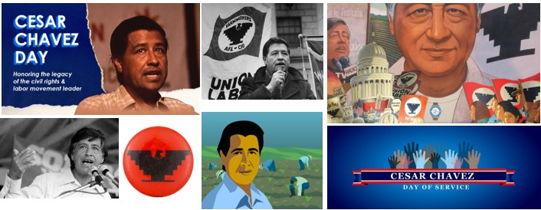
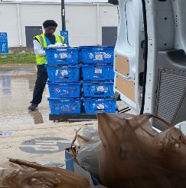
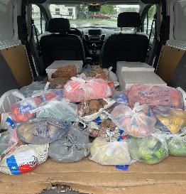
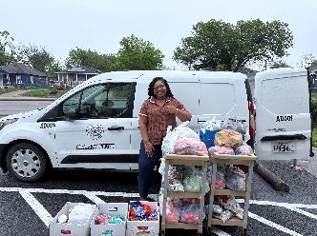
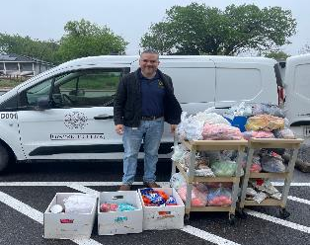
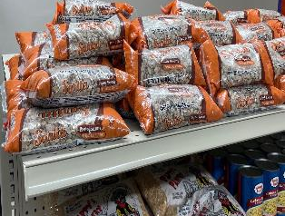
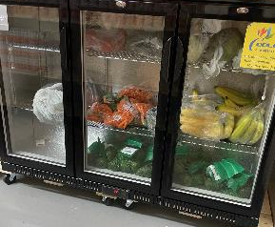
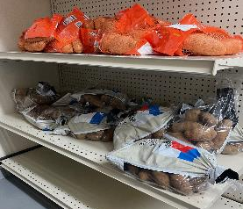
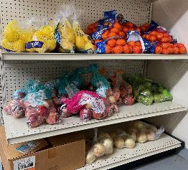
FOOD DRIVE DONATIONS

Slide 14
Contact Us - administration
District Clerk | Felicia Pitre | (214) 653-7301 | fpitre@dallascounty.org
Chief Deputy | Nina Mountique | (214) 653-7445 | nina.mountique@dallascounty.org
Human Resources Manager | Lashon Johnson | (214) 653-6225 | lashon.johnson@dallascounty.org
Executive Assistant | Antonisha Hunter | (214) 653-7301 | antonisha.hunter@dallascounty.org
System Coord / Open Records | Gary Fitzsimmons | (214) 653-6224 | gfitzsimmons@dallascounty.org

Slide 15
Contact Us – Civil
Civil/Family/Juvenile Operations Manager | Connie Jones | (214) 653-6807 | connie.jones@dallascounty.org
Civil Family Court Operations Manager | Danitra Brown | (214) 653-6748 | danitra.brown@dallascounty.org
Asst. Juvenile Courts Operations Manager | Tracey Masters | (214) 698-4910 | tracey.masters@dallascounty.org
Family Court Supervisor | Alejandro Rodela | (214) 653-7173 | alejandro.rodela@dallascounty.org
Civil Court Supervisor | Latanya Barron | (214) 413-4204 | latanya.barron@dallascounty.org
File Desk Supervisor | Na’Thella Wilson | (214) 653-7240 | Nathella.wilson@dallascounty.org
Document Production Supervisor | Shelia Bradley | (214) 653-7049 | sbradley@dallascounty.org
District Clerk | Felicia Pitre | (214) 653-7301 | fpitre@dallascounty.org
Chief Deputy | Nina Mountique | (214) 653-7445 | nina.mountique@dallascounty.org
Human Resources Manager | Lashon Johnson | (214) 653-6225 | lashon.johnson@dallascounty.org
Executive Assistant | Antonisha Hunter | (214) 653-7301 | antonisha.hunter@dallascounty.org
System Coord / Open Records | Gary Fitzsimmons | (214) 653-6224 | gfitzsimmons@dallascounty.org
Juvenile Collections Manager | Sandra Gray | (214) 653-6853 | Sandra.gray@dallascounty.org

Slide 16
Contact Us – Criminal
Criminal Section Manager | Tia Finney | (214) 653-5977 | tia.finney@dallascounty.org
Criminal Courts Operations Manager | Tanya Varnado | (214) 653-5976 | tanya.varnado@dallascounty.org
Criminal Courts Manager | Denise Asberry | (214) 653-5975 | denise.asberry@dallascounty.org
Criminal Courts Supervisor | Sandra Minter | (214) 712-3014 | sandra.minter@dallascounty.org
Criminal Courts Supervisor | Barbie Murphy | (214) 875-2445 | barbie.murphy@dallascounty.org
Felony Collections Coordinator | Brenda Barnett | (214) 653-5784 | brenda.barnett@dallascounty.org
Criminal Process Supervisor | Donald R. Webber | (214) 653-5959 | donald.r.webber@dallascounty.org
Magistrate Court Supervisor | DeJon White | (214) 653-2843 | Dejon.white@dallascounty.org

Slide 17
Contact Us – TRUST AND ACCOUNTING
Trust, Accounting and Collections Manager | George Vent | (214) 653-7315 | george.ventjr@dallascounty.org
Trust Supervisor | Jessica Williams | (214) 653-6055 | jessica.williams@dallascounty.org
Accounting Supervisor | David Bradley | (214) 653-7260 | david.bradley@dallascounty.org

Slide 18
Contact Us – PASSPORT
Passport Assistant Manager (Downtown Dallas) | Maliha Shahzad | (214) 653-6519
Lead Clerk (East Dallas) | Christopher Garza | (214) 321-3183
Lead Clerk (North Dallas) | Yvette Gomez | (214) 904-3032
E-mail us at DCPassports@dallascounty.org

Slide 19
Contact Us – RECORDS
Records Manager | Ahsan Ali | (214) 653-7052 | ahsan.ali@dallascounty.org
Civil/Family Records Supervisor | Eduardo Suarez | (214) 653-6853 | eduardo.suarez@dallascounty.org
Felony Records Supervisor | Christopher Webb | (214) 653-5987 | christopher.webb@dallascounty.org

Slide 20
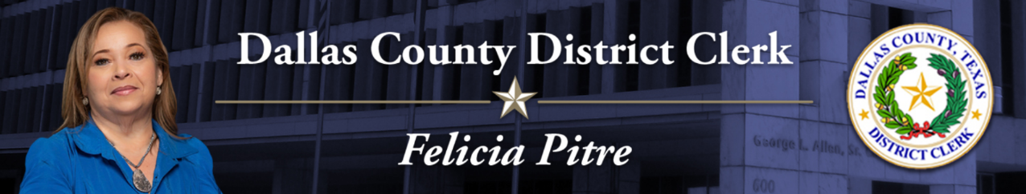
Thank you
214-653-7301
fpitre@dallascounty.org
www.dallascounty.org/government/district-clerk/

