Slide 1

DCHHS Update
Zika Virus
April 5, 2016
Zachary Thompson
Director
Dallas County Health and Human Services
Dr. Christopher Perkins
Medical Director/Health Authority
Dallas County Health and Human Services

Slide 2
Dallas County Confirmed Cases
5 confirmed cases to date (all fully recovered)
  1 imported from Venezuela
  1 through sexual transmission
  1 imported from Honduras
  1 imported from El Salvador
  1 imported from Colombia

Slide 3
DCHHS Timeline/Efforts
January 27
Published webpage
Published public information materials (fact sheets, brochures, posters, etc.)
  Shared information with the public
  at-large
Issued press release announcing campaign
January 28
Established Zika Task Force
February 2
Reported first two cases
Issued DCHHS health advisory
February 5
Issued DCHHS health advisory update
February 10
Reported third case
Published Zika Virus Special Edition newsletter
February 15
Lab began testing
February 19
DMN published DCHHS op-ed
March 1
Reported fourth case
March 8 and 10
Participated on CDC Zika Action Plan Summit planning call
March 11
Hosted annual Pre-Season Mosquito Meeting for Dallas County municipalities
March 14
Began door hanger distribution
March 22
Zika Virus Tabletop
April 1
CDC Zika Virus Action Plan
Reported fifth case
Ongoing:
Weekly Task Force meetings
Issuing State and Federal guidance as received

Slide 4
Zika Virus Lab Testing
DCHHS lab has processed 138 lab specimens
  60 tested at DCHHS
  78 referred to CDC
DCHHS lab can provide results within 24-48 hours
Additional testing done at CDC for cases without active symptoms at the time specimen was obtained
The DCHHS LRN Laboratory can only accept specimens for PCR results from residents of the following counties comprising its service area: Collin, Dallas, Ellis, Fannin, Grayson, Henderson, Hunt, Kaufman, Navarro, Rains, Rockwall, and VanZandt.

Slide 5
DCHHS Efforts
Director Zachary Thompson attended the CDC Zika Virus Action Plan Summit in Atlanta, GA.
DCHHS held the first Zika virus tabletop exercise by a Texas local health department.
Zika door hangers (English and Spanish)
Shared Zika virus prevention information with Apartment Association
Ongoing campaign
Continuing Zika Task Force weekly calls
Surveillance, response
Ongoing communication with State and Federal partners

Slide 6
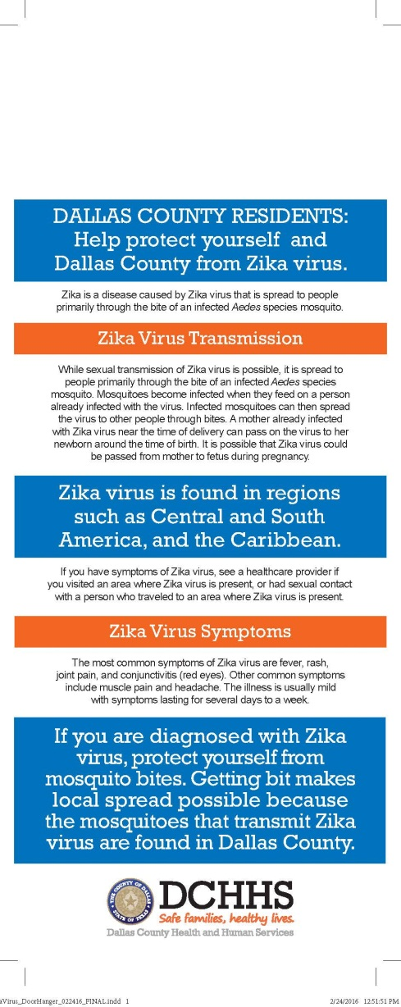
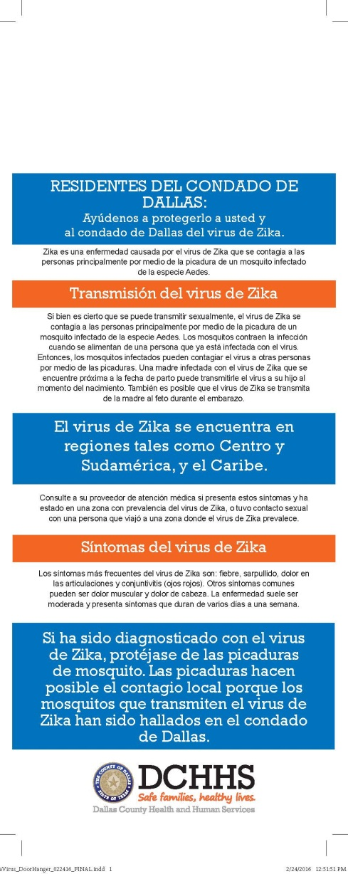
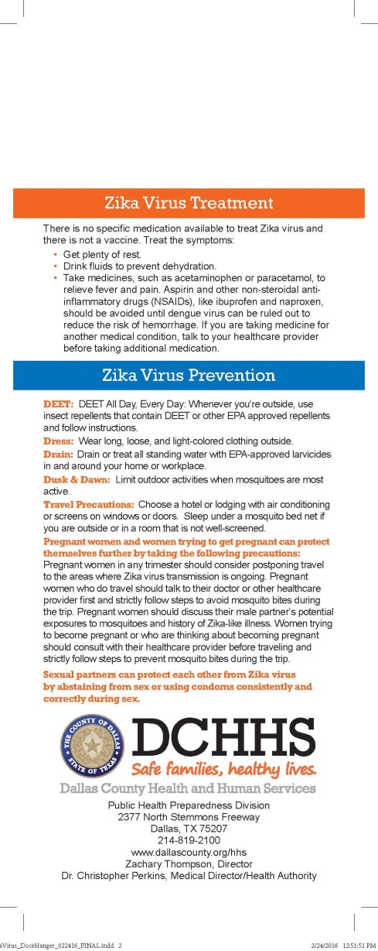
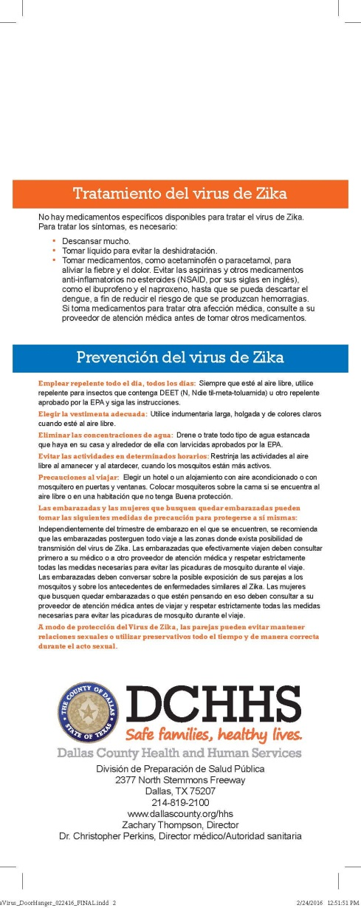

Slide 7
Cities Received Zika Door Hangers

Slide 8
Zika Virus Precautions/Prevention
FOR EVERYONE
If you have Zika virus, avoid mosquito bites for the first week of your illness.
  During the first week of infection, Zika virus can be found in the blood and passed from an infected person to another mosquito through mosquito bites.
  An infected mosquito can then spread the virus to other people.
The best way to avoid Zika virus is to avoid mosquito bites and sexual contact with a person who has Zika virus.
Everyone should use the 4Ds to reduce the chance of being bitten by a mosquito.
  DEET All Day, Every Day: Whenever you’re outside, use insect repellents that contain DEET or other EPA approved repellents and follow instructions.
  DRESS: Wear long, loose, and light-colored clothing outside.
  DRAIN: Remove all standing water in and around your home.
  DUSK & DAWN: Limit outdoor activities during dusk and dawn hours when mosquitoes are most active.

Slide 9
Zika Virus Precautions/Prevention
FOR TRAVELERS, SEXUAL PARTNERS
Travelers can protect themselves further by doing the following:
  Choose a hotel or lodging with air conditioning or screens on windows or doors.
  Sleep under a mosquito bed net if you are outside or in a room that is not well-screened.
Sexual partners can protect each other by abstaining from sex or by using condoms consistently and correctly during sex.

Slide 10
Zika Virus Precautions/Prevention
FOR PREGNANT WOMEN, WOMEN PLANNING PREGNANCY
Delay family planning
Pregnant women and women trying to get pregnant can protect themselves further by taking the following precautions:
  Pregnant women in any trimester should consider postponing travel to the areas where Zika virus transmission is ongoing.
  Pregnant women who do travel to one of these areas should talk to their doctor or other healthcare provider first and strictly follow steps to avoid mosquito bites during the trip.
  Pregnant women should discuss their male partner’s potential exposures to mosquitoes and history of Zika-like illness.
  Women trying to become pregnant or who are thinking about becoming pregnant should consult with their healthcare provider before traveling to these areas and strictly follow steps to prevent mosquito bites during the trip.

Slide 11
Countries and Territories with Active Zika Transmission
AMERICAS
Barbados
Bolivia
Brazil
Colombia
Commonwealth of Puerto Rico, US territory
Costa Rica
Curacao
Dominican Republic
Ecuador
El Salvador
French Guiana
Guadeloupe
Guatemala
Guyana
Haiti
Honduras
Jamaica
Martinique
Mexico
Nicaragua
Panama
Paraguay
Saint Martin
Suriname
U.S. Virgin Islands
Venezuela
OCEANIA/PACIFIC ISLANDS
American Samoa
Samoa
Tonga
AFRICA
Cape Verde

Slide 12
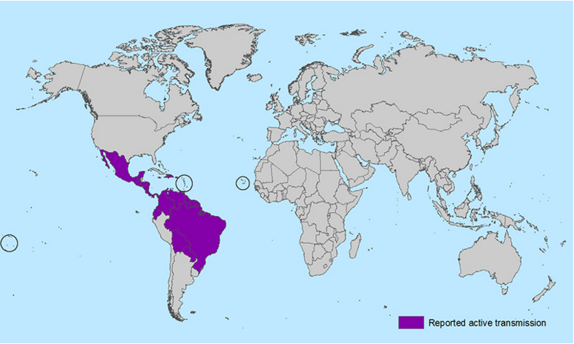
Countries and Territories with Active Zika Transmission

