Slide 1
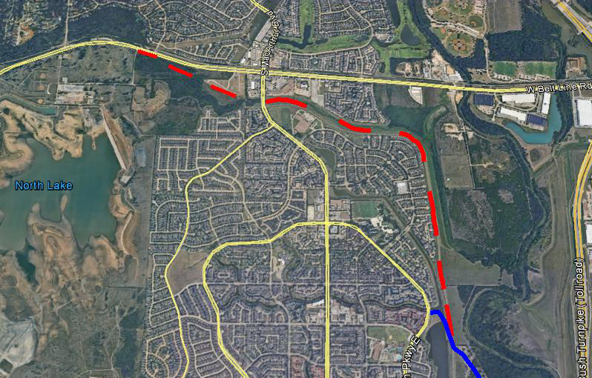
CAMPION-MACARTHUR TRAIL
Upcoming trail
Existing trail

